Slide 1

Sampling Theorem

Slide 2


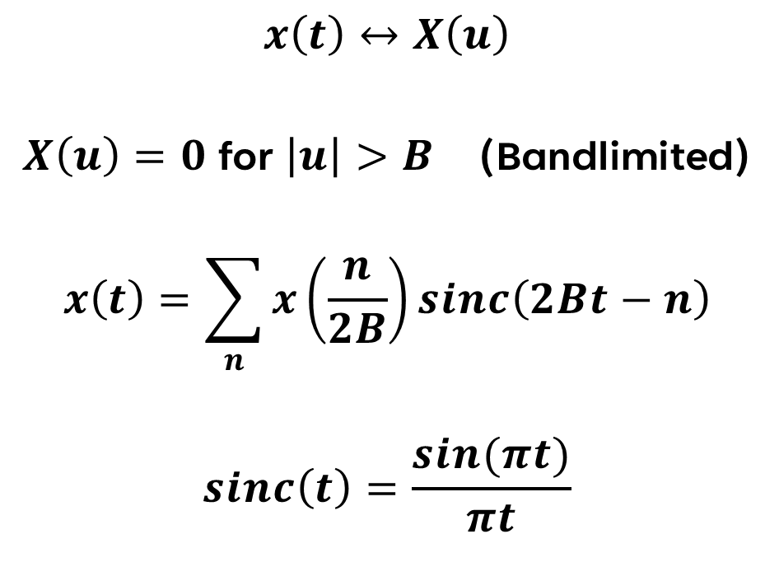
The Sampling Theorem
$$x\left(t\right)↔X\left(u\right)$$
$X\left(u\right)=0$for $\left|u\right|>B$ (Bandlimited)
$$x\left(t\right)=\sum_{n}{x\left(\frac{n}{2B}\right)}sinc\left(2Bt−n\right)$$
$$sinc\left(t\right)=\frac{sin(πt)}{πt}$$

Slide 3


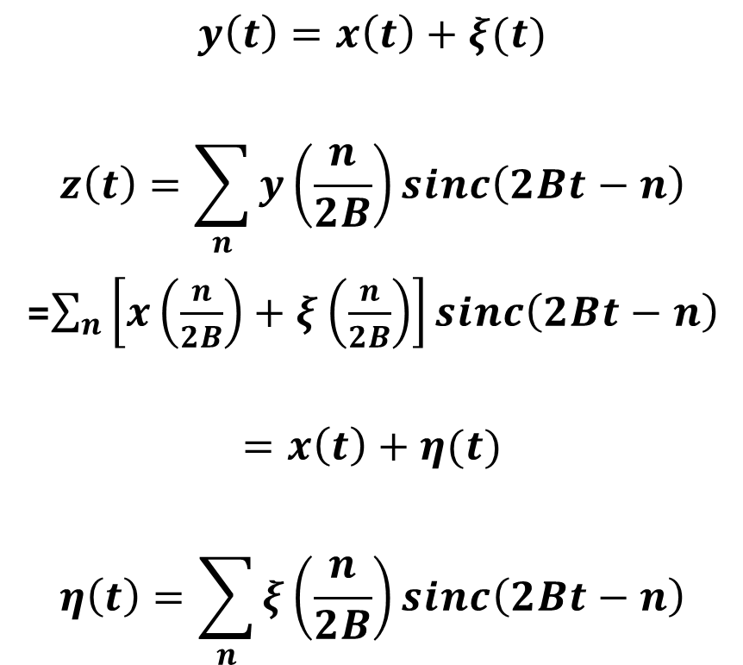
Add WSS Noise $ξ(t)$
$$y\left(t\right)=x\left(t\right)+ξ(t)$$
$$z\left(t\right)=\sum_{n}{y\left(\frac{n}{2B}\right)}sinc\left(2Bt−n\right)$$
=$\sum_{n}{\left[x\left(\frac{n}{2B}\right)+ξ\left(\frac{n}{2B}\right)\right]}sinc\left(2Bt−n\right)$
$$=x\left(t\right)+η(t)$$
$$η\left(t\right)=\sum_{n}{ξ\left(\frac{n}{2B}\right)}sinc\left(2Bt−n\right)$$

Slide 4

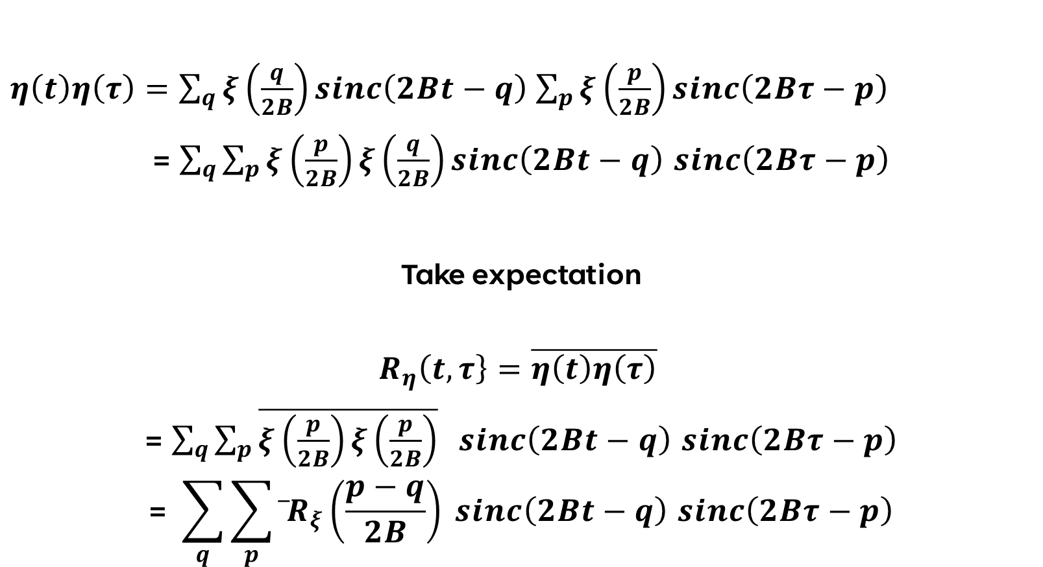
$AUtocorrelation ξ(t)$
$η\left(t\right)η\left(τ\right)=\sum_{q}{ξ\left(\frac{q}{2B}\right)}sinc\left(2Bt−q\right)$ $\sum_{p}{ξ\left(\frac{p}{2B}\right)}sinc\left(2Bτ−p\right)$
= $\sum_{q}{\sum_{p}{ξ\left(\frac{p}{2B}\right)}ξ\left(\frac{q}{2B}\right)}sinc\left(2Bt−q\right)$ $sinc\left(2Bτ−p\right)$
Take expectation
$$R_{η}\left(t,τ\right\}=\overline{η\left(t\right)η\left(τ\right)}$$
= $\sum_{q}{\sum_{p}{\overline{ξ\left(\frac{p}{2B}\right)ξ\left(\frac{p}{2B}\right)} } }sinc\left(2Bt−q\right)$ $sinc\left(2Bτ−p\right)$
$$\text{= }\sum_{q}{\sum_{p}{\overline{ }R_{ξ}\left(\frac{p−q}{2B}\right)} }sinc\left(2Bt−q\right) sinc\left(2Bτ−p\right)$$

Slide 5

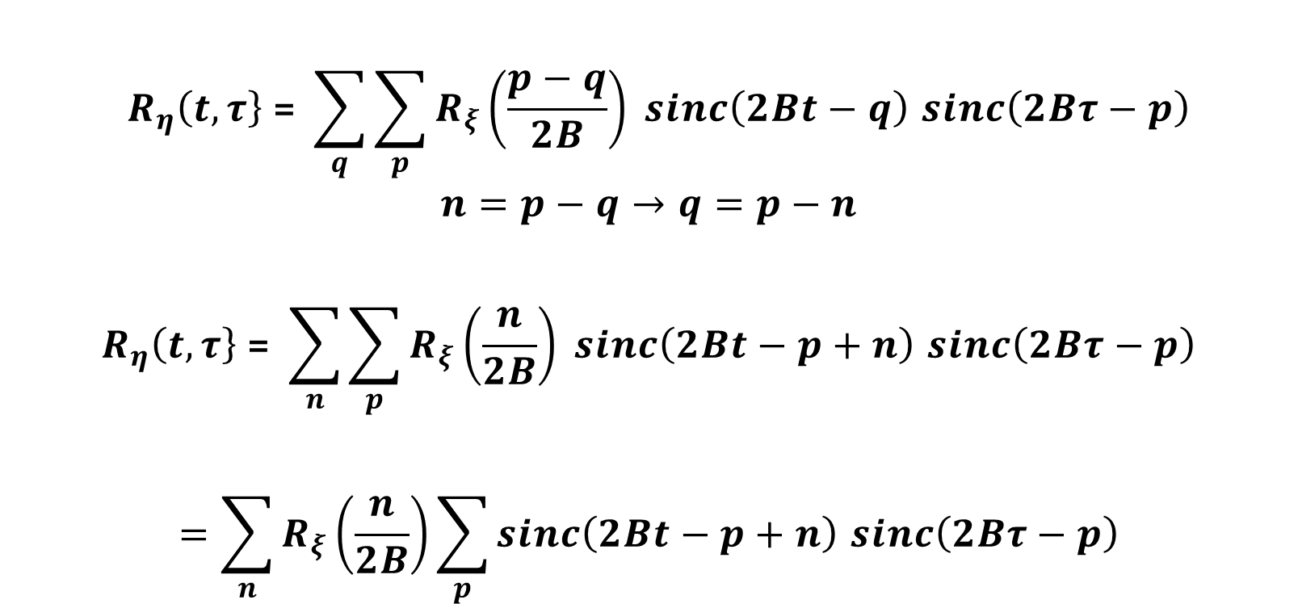

$Change of variable$
$$R_{η}\left(t,τ\right\} \text{= }\sum_{q}{\sum_{p}{R_{ξ}\left(\frac{p−q}{2B}\right)} }sinc\left(2Bt−q\right) sinc\left(2Bτ−p\right)$$
$$n=p−q→q=p−n$$
$$R_{η}\left(t,τ\right\} \text{= }\sum_{n}{\sum_{p}{R_{ξ}\left(\frac{n}{2B}\right)} }sinc\left(2Bt−p+n\right) sinc\left(2Bτ−p\right)$$
$$=\sum_{n}{R_{ξ}\left(\frac{n}{2B}\right)\sum_{p}{sinc\left(2Bt−p+n\right) sinc\left(2Bτ−p\right)}}$$

Slide 6

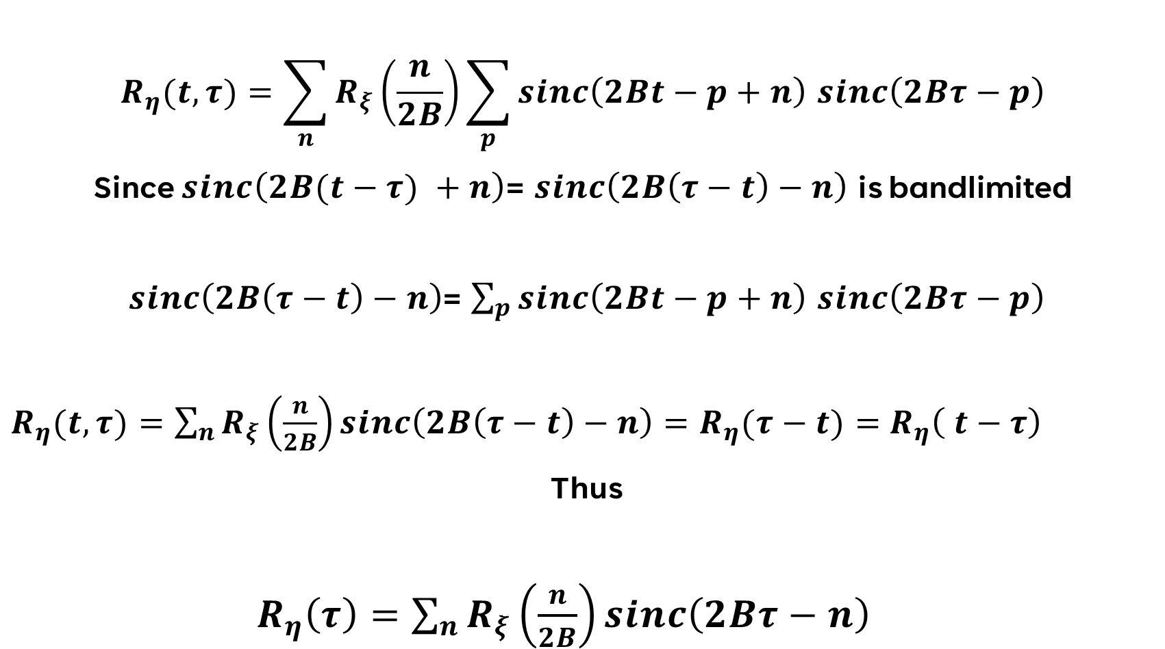
$Evaluation of series$
$$R_{η}(t,τ)=\sum_{n}{R_{ξ}\left(\frac{n}{2B}\right)\sum_{p}{sinc\left(2Bt−p+n\right) sinc\left(2Bτ−p\right)}}$$
Since $sinc\left(2B(t−τ) +n\right)$= $sinc\left(2B\left(τ−t\right)−n\right)$ is bandlimited
$sinc\left(2B\left(τ−t\right)−n\right)$= $\sum_{p}{sinc\left(2Bt−p+n\right) sinc\left(2Bτ−p\right)}$
$R_{η}(t,τ)=\sum_{n}{R_{ξ}\left(\frac{n}{2B}\right)sinc\left(2B\left(τ−t\right)−n\right)=R_{η}(τ−t)=}$ $R_{η}\left( t−τ\right)$
Thus
$R_{η}\left(τ\right)=\sum_{n}{R_{ξ}\left(\frac{n}{2B}\right)sinc\left(2Bτ−n\right) }$

Slide 7
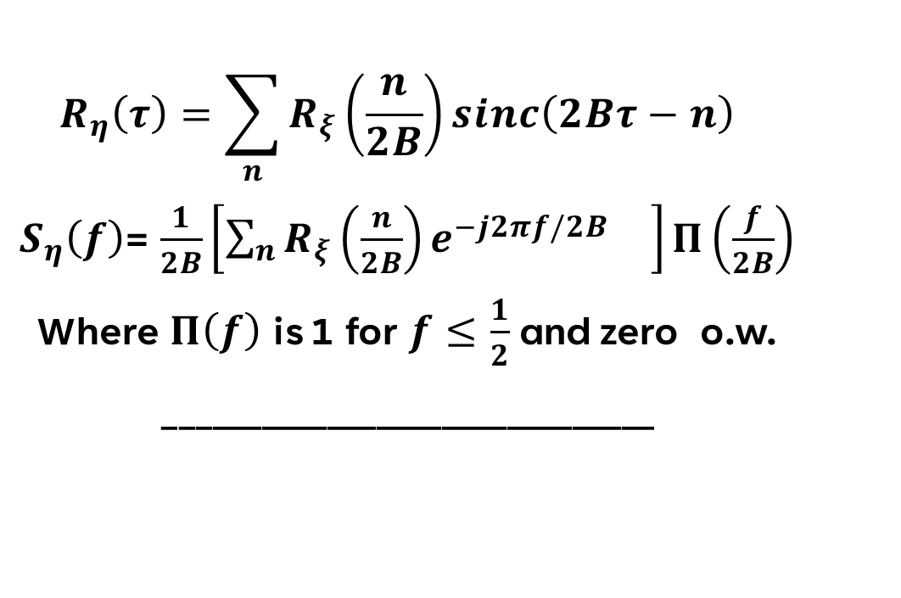

$Power spectral density$
$$R_{η}\left(τ\right)=\sum_{n}{R_{ξ}\left(\frac{n}{2B}\right)sinc\left(2Bτ−n\right) }$$
$S_{η}\left(f\right)$= $\frac{1}{2B}\left[\sum_{n}{R_{ξ}\left(\frac{n}{2B}\right)e^{−j2πf/2B} }\right]Π\left(\frac{f}{2B}\right)$
Where $Π\left(f\right)$ is 1 for $f≤\frac{1}{2}$ and zero o.w.
______________________________
$$if noise samples are white (uncorrelated)$$

Slide 8
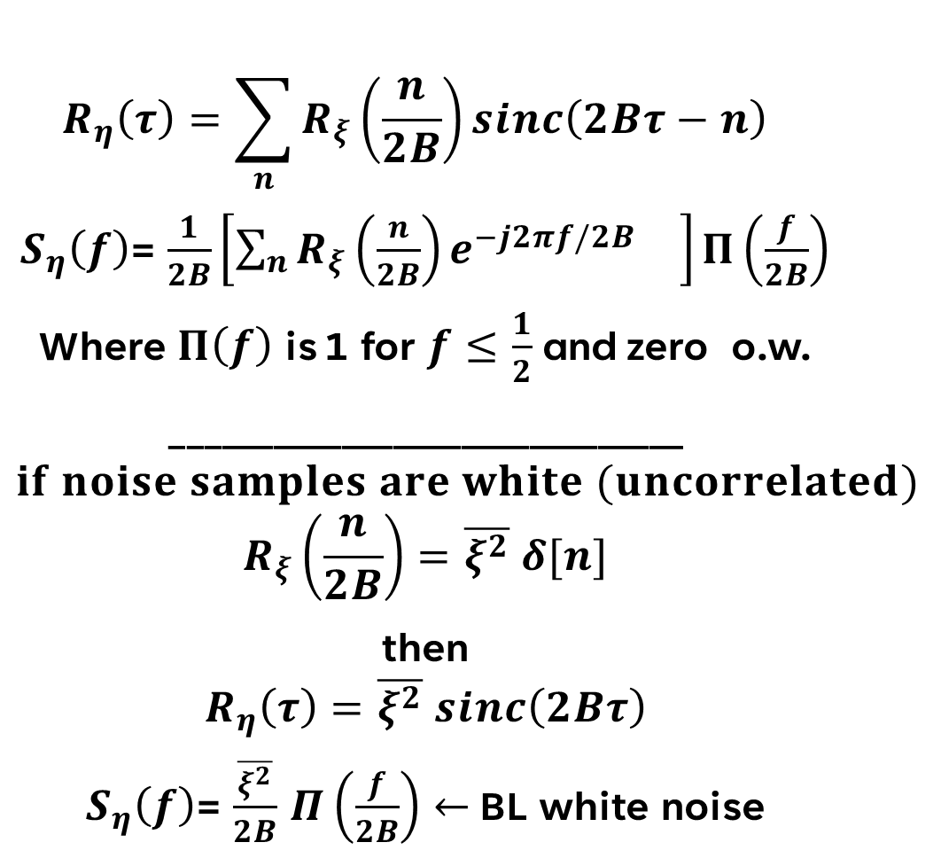
$Power spectral density$
$$R_{η}\left(τ\right)=\sum_{n}{R_{ξ}\left(\frac{n}{2B}\right)sinc\left(2Bτ−n\right) }$$
$S_{η}\left(f\right)$= $\frac{1}{2B}\left[\sum_{n}{R_{ξ}\left(\frac{n}{2B}\right)e^{−j2πf/2B} }\right]Π\left(\frac{f}{2B}\right)$
Where $Π\left(f\right)$ is 1 for $f≤\frac{1}{2}$ and zero o.w.
______________________________
$$if noise samples are white (uncorrelated)$$
$$R_{ξ}\left(\frac{n}{2B}\right)=\overline{ξ^{2}} δ[n]$$
then
$$R_{η}\left(τ\right)=\overline{ξ^{2}} sinc\left(2Bτ\right)$$
$S_{η}\left(f\right)$= $\frac{\overline{ξ^{2}}}{2B}$ $Π\left(\frac{f}{2B}\right)←$ BL white noise

